Slide 1
Before the Badge
Seattle Police Department
2023

Slide 2
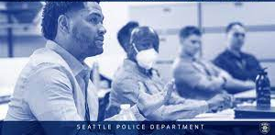
What is Before the Badge?
Seattle Police Department Led five-week program that provides new recruits information on:
Relationship building within the community
Officer wellness
SPD precincts, opportunities, and leadership

Slide 3
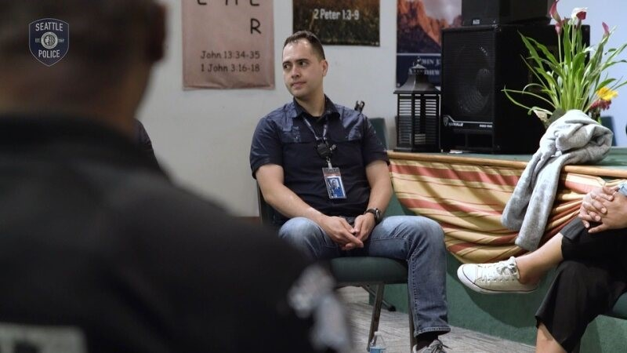

Slide 4
Before the Badge Program Curriculum Preview
Community & Cultural Awareness
Chinatown International District
Filipino Community Meeting
Latino/Latinx Community Meeting
Black Owned Business Tour
Indigenous History
East African Community Meeting
Middle Eastern Community Meeting
Officer Wellness
The Science of Relational Policing
Growth Mindset
Outward Mindset
SPD Wellness Unit

Slide 5
Program Participant Overview

Slide 6
Importance of Community Participation
Community Perspective
Meaningful Partnerships
Building Community Connections

Slide 7

Future of Before the Badge
Before the Badge
360
Patrol Officers
Field Training Officers
Command Staff

Slide 8
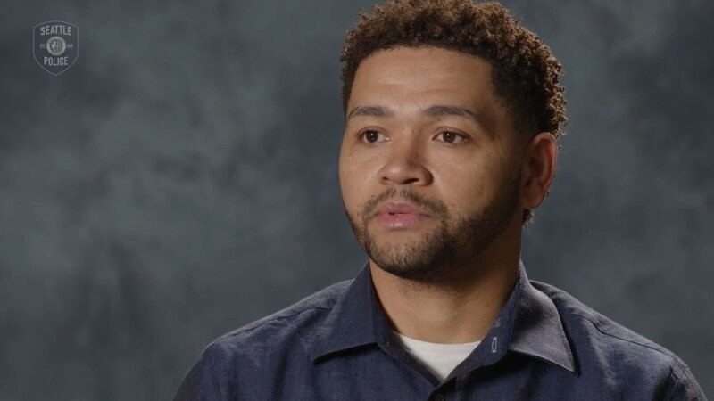

Slide 9

Questions?

Slide 10
Before the Badge Program Contacts
Brandon James, Lieutenant
brandon.james@seattle.gov
206-423-9957
Dr. Jameelah Cage, Relational Policing Coordinator
Jameelah.cage@seattle.gov
206-617-6014
Before The Badge (BTB) - Police | seattle.gov

