Slide 1
10 Week Corrections Officer’s Academy

Slide 2
Ten Week Content
We based the 10 Week Content on:
Our Current Curriculum
Occupational Analysis
GAP Study
C/DT Study
Best Practices
Legislation

Slide 3
How was the 10 week developed?
How we got here:
2017 – Occupational Analysis
2018 – COA Expansion Request
2019 – Trueblood Settlement
2020 – RCW 43.101.220 Adopted
2020 – C/DT Survey Conducted
2020 – GAP Analysis Completed
2020 – Curriculum Build Started With CJTC Staff
Moving forward:
Curriculum Materials Sent to Rice Performance
July 2021 – Pilot Class 474 Begins July 1st,2021
Evaluation of Pilot Program, Work With Rice Performance to Make Necessary Adjustments.
Notes:
This process was started nearly four years ago. Input was sought through several sources, WASPC being one of them.
Our current focus is on our pilot class 474 Starting July 1st, 2021
The pilot is built with the idea that with any course things will work and things wont. Adjustments need to be made.

Slide 4
Ten Week Content
Legislative Requirements:
Observation Skills
Communication Skills
Security Management
Supervision of Inmates
Discipline of Inmates
Proper Use of Physical Force
Writing Skills
Legal Issues
Stress Management
Physical Fitness
Self-leadership
Professionalism
Human Relations/Cultural Awareness
Dealing with Aggressive behavior
Dealing with Medical Behavior
Dealing with Mental Illness Problems
Problem Solving
Report Writing
Avoiding Inmate Manipulation
Booking and Classification
Fingerprinting
CIT

Slide 5
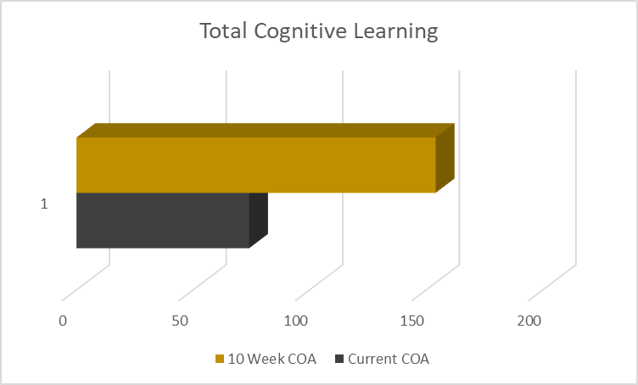
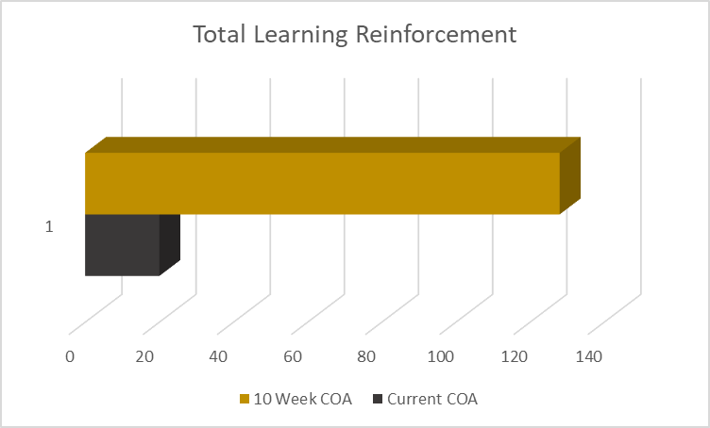
Hours Breakdown
Cognitive
Learning
Physical Skill
Learning
Learning
Reinforcement
Up 108%
Up 110%
Up 540%
Notes:
Total cognitive learning from 74 hours to 154 hours
Total physical skill learning from 58 hours to 118 hours
Reinforcement 20 hours to 128 hours

Slide 6
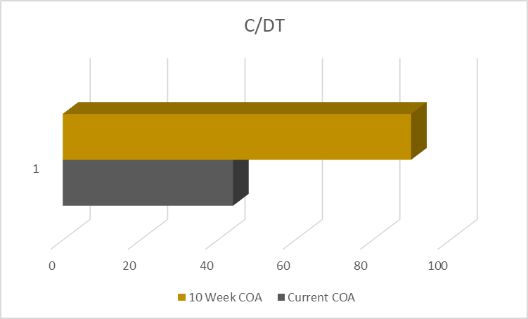
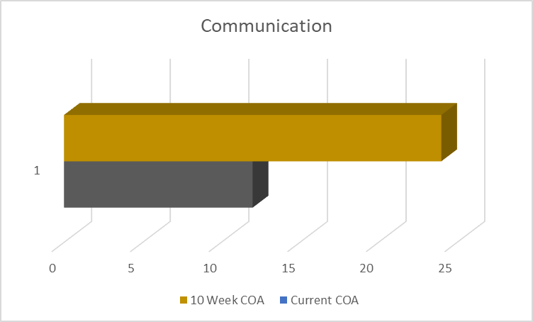
Hours Breakdown
Security
Management
C/DT
Communication
Up 104%
Up 100%
Up 100%
Notes:
C/DT from 44 hours to 90 Hours
Security management from 14 hours to 28 hours
Communication from 12 hours to 24 hours (Now includes CIT)

Slide 7
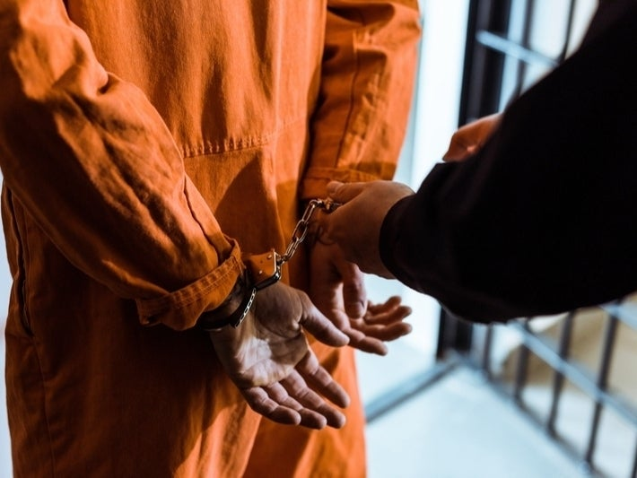
New Courses
Race in the criminal justice system
C2
History of corrections
The criminal justice system
Critical Incident
Classification/Discipline
PREA
Fitness
TASER

Slide 8
Evaluation, Retention and Testing
Benchmarks:
Recruits will report back to their agencies weekly.
TAC Officers will report back after each phase of the academy.
There will be both a midterm and a final written exam.
Final overall testing will be in mock scene form, consistent with BLEA.
Mock Scene Testing Criteria:
5 Overarching Principals
Legal Authority
Communication
Position and Movement
Threat Management
Equipment Management

Slide 9
10 Week Breakdown

Slide 10
How does the 10 Week COA affect :
Equivalency academy?
Police Support Officer?
PAT?
Firearms?

Slide 11
Questions?

