Slide 1
WASPC ACCREDITATION
Quarterly Training
October 14, 2026
David Doll Director of Professional Services
Randy Maynard Assistant Director of Professional Services
D

Slide 2

Recent assessment issues
Accreditation manager training
Assessor training
Questions?
Next training date 3/17/27

Slide 3

WASPC ACCREDITATION
THANK YOU!!!
Notes:
Randy

Slide 4
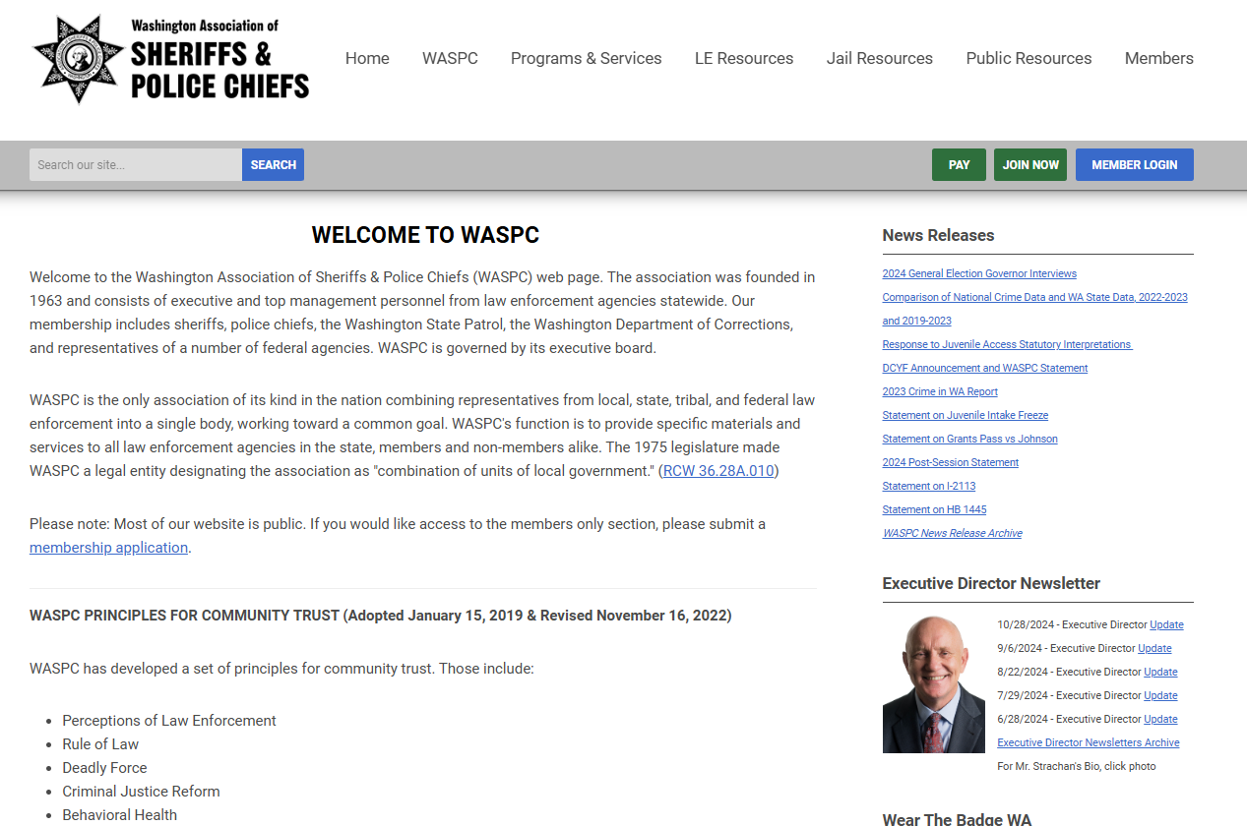
www.waspc.org
Notes:
Whether you represent a law enforcement agency or a correctional facility, this is the place to find all things Accreditation.

Slide 5
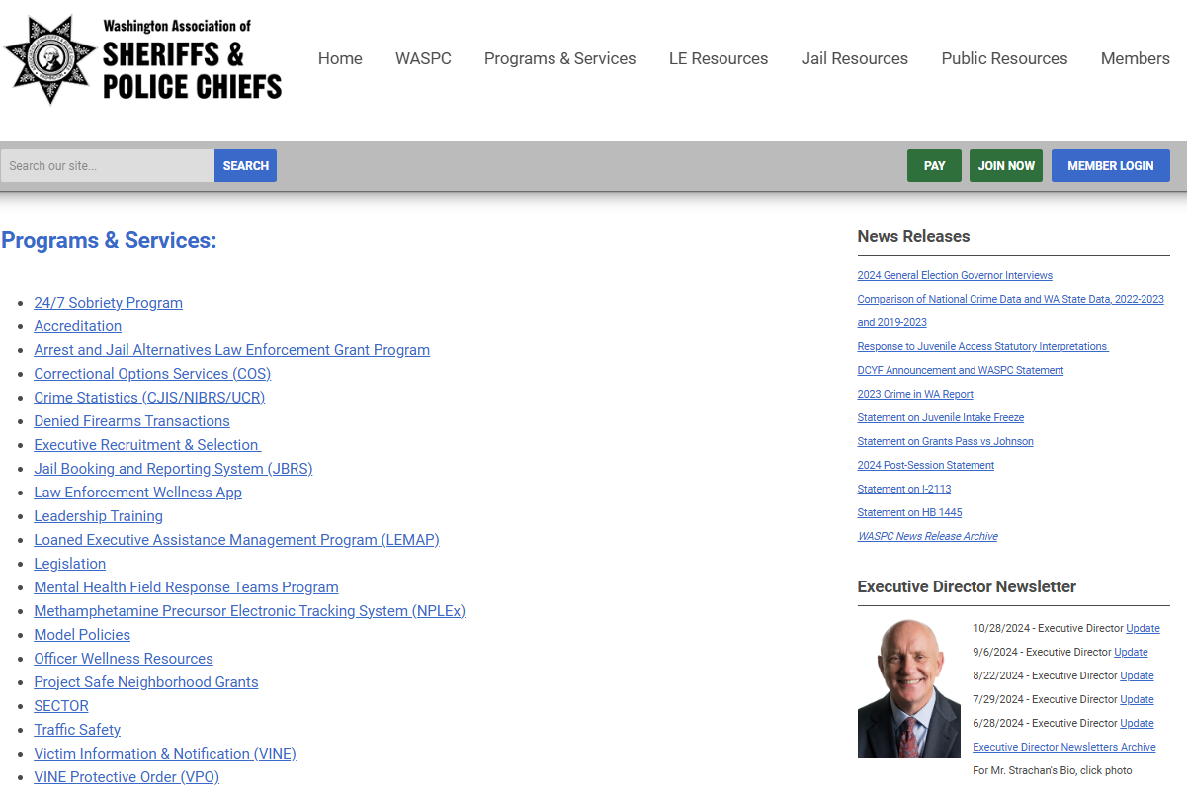
www.waspc.org

Slide 6
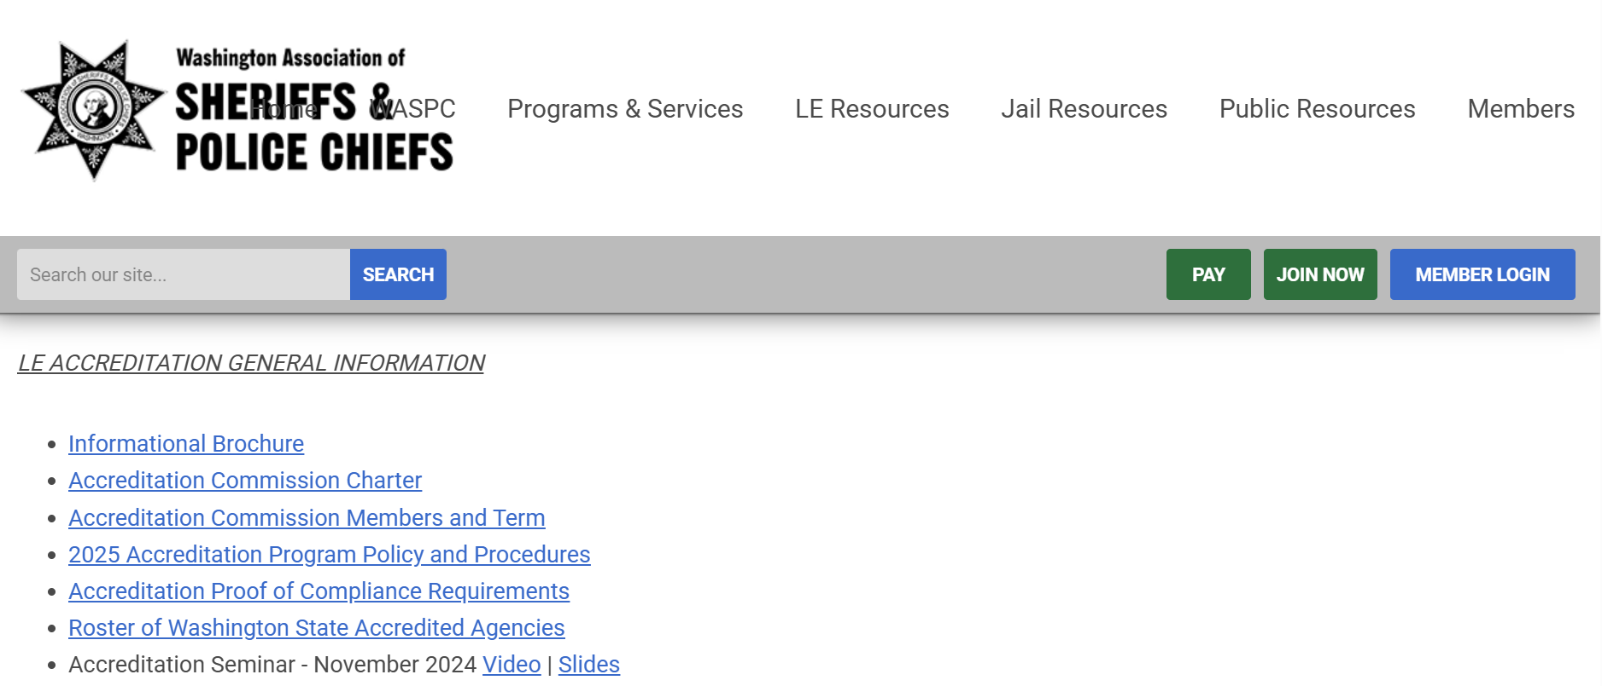
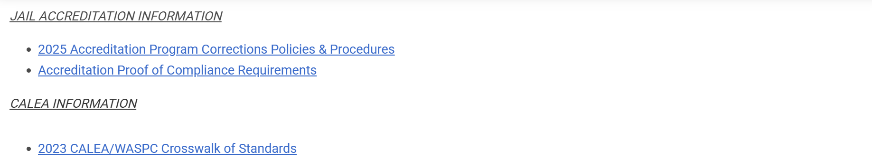
www.waspc.org/accreditation

Slide 7
Goals and Objectives 1.2
Goals and Objectives
The agency has a strategic plan or written goals and objectives that are reviewed and updated at least annually and are available to all personnel *
Evidence/Proof of Compliance
Annual updates or reports on progress toward G&O or Strategic Plan.
Documents identifying work on G&O/SP in each of the past four years
Check for any policy that addresses process or frequency of review/update

Slide 8
Juvenile Access to Counsel Prior to Interrogation 2.8
The agency has policies that ensure any juvenile (under age 18) will have access to an attorney for consultation before the juvenile waives any constitutional rights if the officer/deputy:
Questions a juvenile during a custodial interrogation,
Detains a juvenile based upon probable cause of involvement in criminal activity, or;
Asks a juvenile to authorize a consent search of their person, property, dwelling or vehicle under the juvenile’s control.

Slide 9
Juvenile Access to Counsel Prior to Interrogation 2.8 (cont’d)
Proof of Compliance
Agency policy
Incident or supplemental report narrative documenting contact with counsel
Memo to file if no incidents

Slide 10
Use of Force 3.1
Use of Force
The agency has policies directing personnel to utilize force as prescribed by federal, state and local laws.
Purpose: To provide clear direction to peace officers that complies with the law and provides a clear understanding of the limitations on their authority to use force.
Evidence/Proof of Compliance
Policy covering all use of force
Case report supporting compliance with policy
R
Notes:
Randy Starts Here

Slide 11
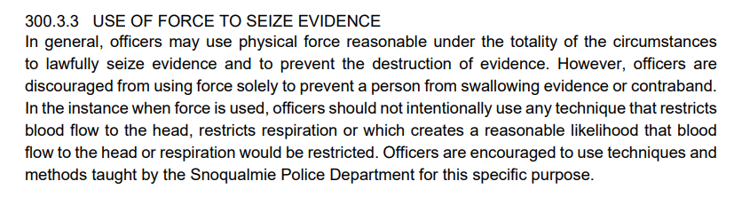
Use of Force 3.1
Use of Force
Watch for this template language from Lexipol:

Slide 12
Use of Force 3.6
Investigations of Deadly Force
The agency has an officer involved shooting/deadly force response policy that includes steps for first responders and includes a comprehensive Independent investigation and review of the event.
Purpose: To ensure the agency has in place a formal response, review and investigative process for officer involved shootings that result in injury or loss of life, that comply with state law to protect interests, rights, and mental health of involved officers.

Slide 13
Standard 3.7* (1/1/2026)
Authorized Weapons and Ammunition
The agency has policy requiring only authorized weapons and ammunition shall be carried and / or used on duty and an annual inventory of all agency-owned handguns and rifles shall be conducted and acknowledged by the agency CEO.
Evidence/Proof of Compliance
Annual inventory and report to agency CEO
Note this is an annual standard*
Notes:
This edit has been approved becomes effective 1/1/2026. Agencies accrediting in 2027 will need to proof compliance.
Standard 11.11 became effective 1/1/2024. Annual proofs begin 1/1/2025.

Slide 14
Review of Pursuits, Use of Force, Internal Investigations and Bias Based Policing 4.3
The agency has a policy that requires an annual* management review and analysis, with final review approved by the chief executive officer, of the following incidents:
  Vehicle pursuits
  Use of force events
  Internal investigations
  Bias based profiling incidents
Evidence/Proof of Compliance
Policy meeting the standard – watch for permissive language
Documentation supporting policy
  Memo to CEO with analysis covering each area of standard
  Can combine all four areas into one annual memo
Notes:
David

Slide 15
Management, Staffing, Organization and Utilization of Personnel 4.4
Written Directives
The agency has a system of written directives that includes procedures for developing, approving and disseminating directives to all personnel. The system will include:
  Methods for tracking changes and archiving prior versions of policies;
  A process that confirms receipt of directives by affected personnel.
Evidence/Proof of Compliance
Policy meeting the standard
Read receipt, report or acknowledgement roster of policy
updates and directives accepted by employees
D
Notes:
David Starts Here

Slide 16
Records Management 5.3
ACCESS Compliance
The agency has polices governing its compliance with all rules for ACCESS participation, to include:
The agency can show 100% compliance or has made corrections to comply with any ACCESS findings from the previous triennial audit
The agency can show that all personnel have been trained and certified
Evidence/Proof of Compliance
  Policy that meets standard
  ACCESS business audit certificate
  Current ACCESS user roster printed no more than 7 days before
  onsite. Ensure everyone is current on roster.
Notes:
WSP thing. Ability for them to keep the doors open for you.
Business audit is in Chapter five, and technical is in chapter 6.
WSP issues certificate. Show everyone is up to date on access certifications.

Slide 17
Health and Safety 8.3
Soft Body Armor
  The agency provides soft body armor and requires its use for personnel engaged in uniform field duties or high-risk situations.
Evidence/Proof of Compliance
Policy that supports standard
Copy of current replacement schedule/roster
Interview with person responsible for replacement
Notes:
We need to see your policy that addresses this standard along with a roster of your commissioned personnel and their vest assignment/replacement dates.
During our onsite we will be looking for people following this policy.

Slide 18
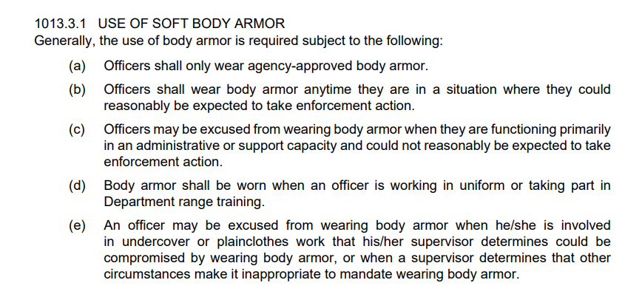
Lexipol template policy:

Slide 19
Health and Safety 8.5
Biohazard Disposal and Decontamination
The agency has procedures for disposal and decontamination when there is an event or contact involving biohazard material including blood or bodily fluids.
Evidence/Proof of Compliance
Equipment, space, processes to facilitate decontamination
Policy or Exposure control plan that supports standard
  Beware of training requirements listed in policy
Interview of Officer/Deputy or Supervisor to ensure compliance
Notes:
This is usually lacking in Lexipol’s Communicable Diseases policy and needs to be added – looking for actual procedures so folks know what to do.
Where do they go and what do they do to mitigate exposure to themselves, their clothing/uniforms, their cars. Do you have the proper cleaning equipment? – stuff like that.
Think about 3am. If they get exposed at that time, do they know what to do?

Slide 20
Recruitment and Selection 10.4
Psychological Examinations
The agency requires that a licensed psychologist or psychiatrist conduct a psychological fitness examination for each candidate for a sworn position, prior to appointment.
Evidence/Proof of Compliance
Copy of redacted psychological report
Copy of invoice for services
Licensing credentials for practitioner from DOL/DOH
Copy of policy or procedure that supports standard
See WAC 139-07-030
Notes:
The psychological examination shall be administered by a qualified professional who is a psychiatrist licensed in the state of Washington pursuant to chapter 18.71 RCW or a psychologist licensed in the state of Washington pursuant to chapter 18.83 RCW.
DOH has these records, include in file.

Slide 21
Training 11.7
WSCJTC Certifications
Staff members who are designated as full-time supervisors or managers have earned the appropriate certification by the Washington State Criminal Justice Training Commission.
Evidence/Proof of Compliance
Roster of employees at the rank of Sergeant and above, including CEO + Promotion dates.
The 40-hr class alone does not a career-level certification make.
Copies of CLC Certificates.
See RCW 43.101.350
Notes:
This is actually required by RCW 43.101.350.
Provide a roster of your supervisory guns and badges people, Sergeant all the way to the top, and indicate their certification dates.
First Level for your line-level supervisors, typically Sergeants, and Middle Management for your Lt.s (or middle mangers and Above).
Provide sample certificates as well.

Slide 22
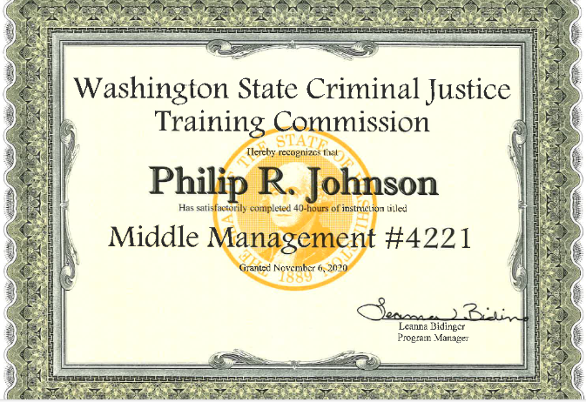
11.7 Career Level Certifications
Notes:
David

Slide 23
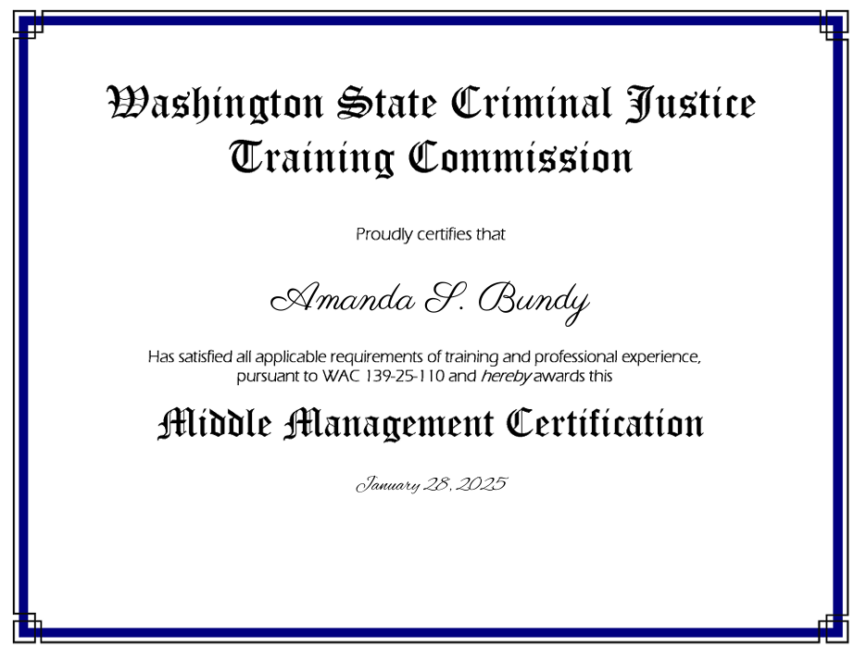
11.7 Career Level Certifications

Slide 24
Training 11.7
WSCJTC Certifications
Staff members who are designated as full-time supervisors or managers have earned the appropriate certification by the Washington State Criminal Justice Training Commission.
Evidence/Proof of Compliance
Roster of employees at the rank of Sergeant and above, including CEO + Promotion dates.
The 40-hr class alone does not a career-level certification make.
Copies of all CLC Certificates.
Notes:
This is actually required by RCW 43.101.350.
Provide a roster of your supervisory guns and badges people, Sergeant all the way to the top, and indicate their certification dates.
First Level for your line-level supervisors, typically Sergeants, and Middle Management for your Lt.s (or middle mangers and Above).
Provide sample certificates as well.

Slide 25
Training 11.9
Non-lethal Training
In-service training for Non lethal weapons shall occur at least once every two years.
Evidence/Proof of Compliance
Spreadsheet of all employees that carry authorized less lethal weapons that includes a list of all authorized weapons and dates of training.
Bi-annual training roster
Challenging standard to prove/maintain compliance
Notes:
The best way to do this is provide a yearly roster of your employees with columns representing type of assigned non-lethal weapon. Provide the dates of training for each assigned weapon.

Slide 26
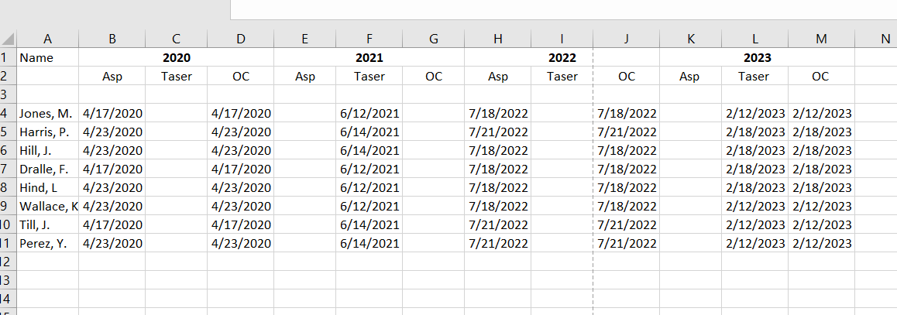
Proof example for less-lethal training standard

Slide 27
De-escalation Training 11.10
The agency provides violence de-escalation training to peace officers as required by the Washington Criminal Justice Training Commission.
Proof of Compliance
Training roster showing personnel have completed de-escalation training at the time of the final file review. Include dates of training.
Copy of agency commissioned personnel roster in this file for the year of file review.
D
Notes:
David Starts Here
Law Enforcement Training and Community Safety Act (LETCSA).
Currently measuring progress. 2-hour CJTC Cti course does not apply. Primarily looking at the 24 hour Patrol Tactics Course.

Slide 28
Code of Conduct 13.5
Impeachment and Disclosure Information
The agency has written policy governing disclosure of potential impeachment information to prosecutors involving police employees who may be called to testify under oath
Evidence/Proof of Compliance
Policy supporting standard and mirrors agency practice
  Copy of redacted memo, email or other communication to file
  RCW 10.93.180 (10 reporting requirement)
Notes:
randy

Slide 29
Investigative Function 16.7
Use of Informants
The agency has policies and procedures governing the use of informants.
Evidence/Proof of Compliance
Policy or procedure meeting standard
Interview with detective or sergeant
Redacted informant file to confirm compliance with standard and local agency policies.
Audits of investigative funds? (see 9.6)
R
Notes:
Be aware of records retention rule regarding informant files: Lexipolians Policy: (Confidential Informants)
Lexipolians have a section called “FILE PURGING” which states: “All CI files should be purged after the case has been fully adjudicated and a disposition has been received, and/or no cases are pending” I would argue that needs to be changed to Shall per Washington Law Enforcement records retention rule which states: “8.2 Intelligence (page 67) :Retain until termination of confidential informant status then Destroy.”
We interpret that to be if you are no longer actively using an informant, their file should be destroyed. Now, please consult with your local legal expert on this one because at the end of the day you want to be able to protect your informants from public disclosure.
Also, be aware of records retention rules for investigative funds 8.1 page 60: Retain for 10 years after date of last expenditure then Destroy.

Slide 30
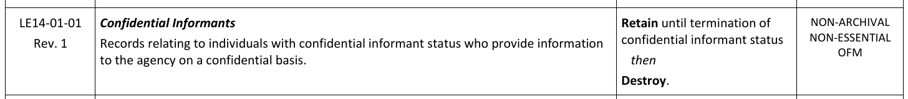
LE Records Retention Schedule
Version 9.0 (June 2026)

Slide 31
Evidence and Property Control Function 17.3
Booking - Booking Before End of Shift
Booking – The agency has policy that require Property and evidence is placed under the control of the property and evidence function before the officer completes their shift.
Evidence/Proof of Compliance
Policy or procedure that meets standard
Copy of case report indicating chain of custody and timing
Interview with officer/deputy to confirm protocols
No exceptions to this standard
Notes:
Lexipolians be aware of this template language:
“All property must be booked prior to the employee going off-duty unless otherwise approved by a supervisor.”
Nope! There are no exceptions.
Acceptable language is “All property must be impounded prior to the employee going off-duty.”

Slide 32
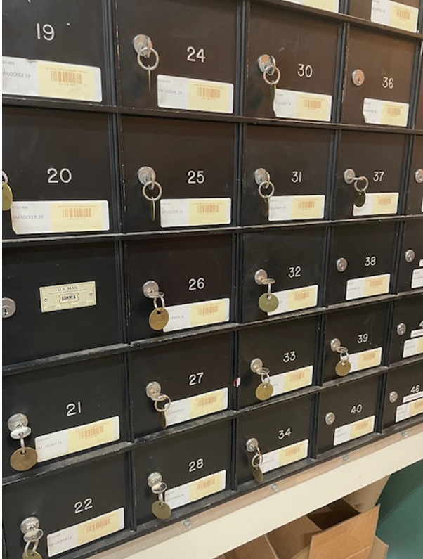
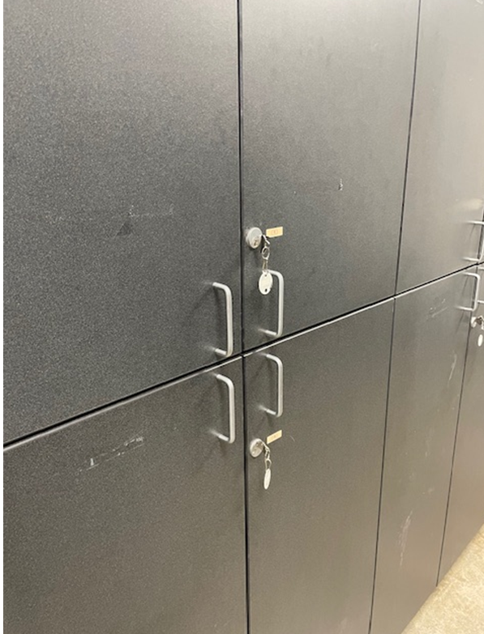

Slide 33
Evidence and Property Control Function 17.5
Perishable Evidence or Property
Booking – The agency has the means to properly preserve and secure perishable property both temporarily and after it is received in the permanent storage facility.
Evidence/Proof of Compliance
Inspection of property room
Interview with property room officer to confirm drying cabinet or freezer(s)
Notes:
This regards your refrigeration and drying units that are in the evidence intake area AND the permanent storage facilities.
You need to have some type of temperature monitoring system in your refrigeration/freezer units that will alert you if the systems fail.

Slide 34
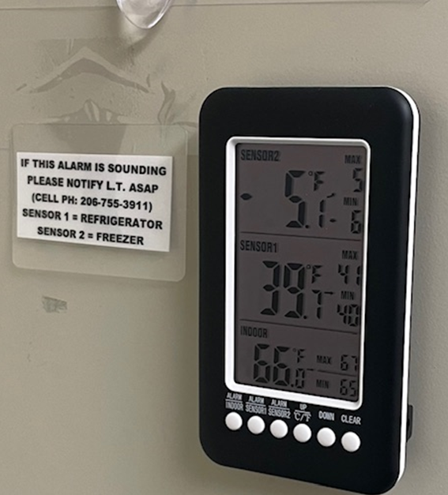
Evidence and Property Control Function 17.5
Perishable Evidence or Property
Notes:
This regards your refrigeration and drying units that are in the evidence intake area AND the permanent storage facilities.
You need to have some type of temperature monitoring system in your refrigeration/freezer units that will alert you if the systems fail.

Slide 35
Evidence and Property Control Function 17.8
Facility Controls – Preventing Exposure
The permanent storage facility containing biohazards or organic matter has systems in place to prevent the exposure of hazards and noxious odors to agency employees and the public.
Evidence/Proof of Compliance
Inspection of property room to confirm ventilation
Interview with property room officer
Notes:
Make sure the nasty air is being pumped out of your evidence storage rooms and not just circulated by a fan
We check this on onsite. Like I have said before, Mike usually sends me in first.

Slide 36
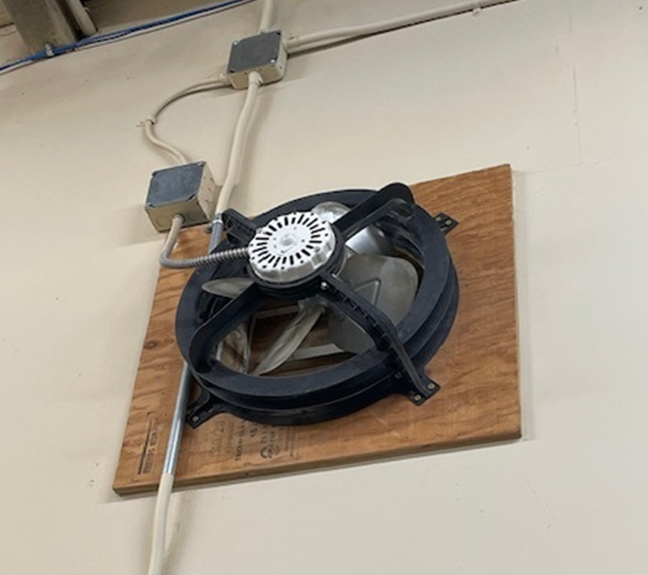
Evidence and Property Control Function 17.8
Employee Exposure

Slide 37
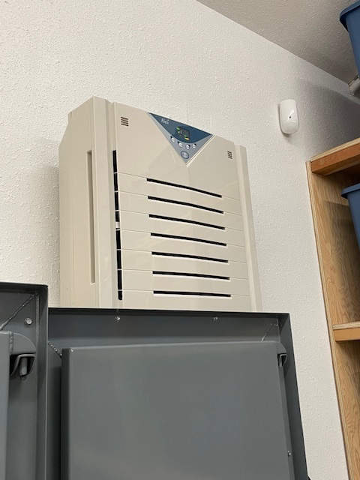
17.8
Employee Exposure
Need to show negative air pressure, not just circulating/purifying air….air needs to leave the room.

Slide 38
Evidence Weighing and Destruction 17.15
The agency has written procedures for the destruction of drug evidence that includes the visual inspection of all packages and the weighing of random packages to detect possible tampering.
Purpose: Agencies should provide additional processes to ensure that drug evidence is not tampered with prior to destruction. This process and the destruction are witnessed by at least one other person who does not have access to the property room.
Evidence/Proof of Compliance
Written procedure to support standard
Memo to file explaining each destruction event including checking of package seals and weighing of random drug items at destruction
Notes:
This standard is about the process by which you destroy eligible drug evidence. New language, in red, is effective as of January 1st, and the new language was designed to clear up some confusion AND to indicate the intent of the standard which is to have documented process.
A written procedure will be your proof of compliance along with a memo to file, or “after-action” report detailing your process.
The additional language changes clarify that all packages need to be inspected for tampering and that random packages need to be weighed.

Slide 39
QUESTIONS?

Slide 40
Accreditation Manager’s Role
  Simply put, you are proving agency compliance to WASPC Accreditation standards.

Slide 41
Accreditation Manager
  Where to start?
    Policy manual status?
    PowerDMS account established?
    Do you have help with managing Accreditation?
Notes:
Agency who is new to Accreditation – Have you requested a pre-Accreditation assessment? What is the status of your policy manual implementation and distribution? Are the acknowledgements complete and documented?
Re-Accrediting agency – Does your agency maintain policy updates (whether Lexipol or organic manual)? Who ensures acknowledgements are occurring?
The question regarding help with Accreditation will matter in setting up the PowerDMS account as well as adding users when the assessment occurs.

Slide 42
PROVING COMPLIANCE
  A few words on “proofs”:
  Agencies must show proof they follow their own policy.
    For standards requiring annual work *, agencies must have proof from all four years leading up to re-accreditation.
  Consistency amongst proofs.
  Final arbiter of whether a proof is sufficient for compliance is the Director of Professional Services.

Slide 43
What is a Proof?
Evidence supporting compliance with standard.
Case report, specific form (ex: use of force/completed forms), memo or directive, photos.
Proofing requirements:
  New Accrediting agency – supply proofs from no more than one year (12 months) prior to the virtual assessment.
  Re-Accrediting agency – supply proofs from within the last two years leading up to the re-accrediting year. In some cases, the proof can be from any time over the past four-year accreditation cycle.

Slide 44
When you see the words:
Policies
Procedures
Agency requires
  A document is required as part of your proofs showing you have some type of policy, procedure or order that satisfies the standard's requirement. Here are a couple examples:
Notes:
David

Slide 45


When you see the words:

Slide 46
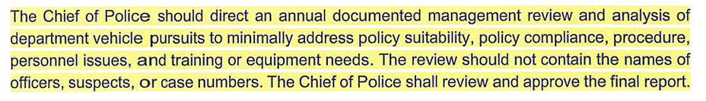
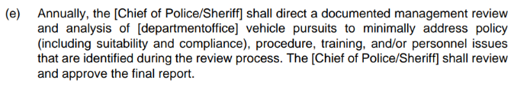
WATCH FOR Permissive Policy Language
VS.
D

Slide 47
Permissive Policy Language
401.6 STATE REPORTING The Deputy Chief shall review available data related to traffic stops, including demographic data, existing procedures, practices and training, as well as complaints. The data should be analyzed for any patterns or other possible indicators of racial- or bias-based profiling and included in an annual report for the Washington Association of Sheriffs and Police Chiefs (RCW 43.101.410(3))
D

Slide 48
File Construction Hints!
Work closely with your mentor!!!!
Files are automatically set up in Power DMS and normally only need to be populated in the system.
In Power DMS, hyperlink and highlight sections of policy, reports, or memos specific to show compliance with the standard.
Confirm agency policy complies with the WASPC standards before starting the proofing process!
DO NOT OVER PROOF FILES!
D

Slide 49
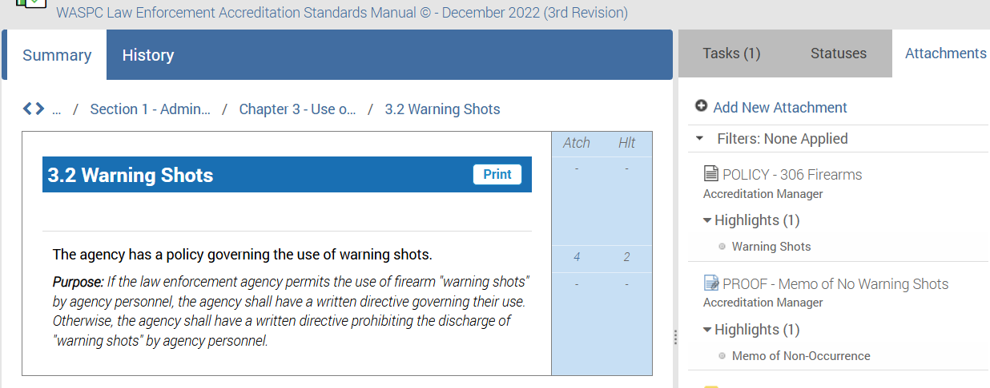
Hyperlink applicable policy sections
D
D

Slide 50
Hyperlink applicable policy sections

Slide 51
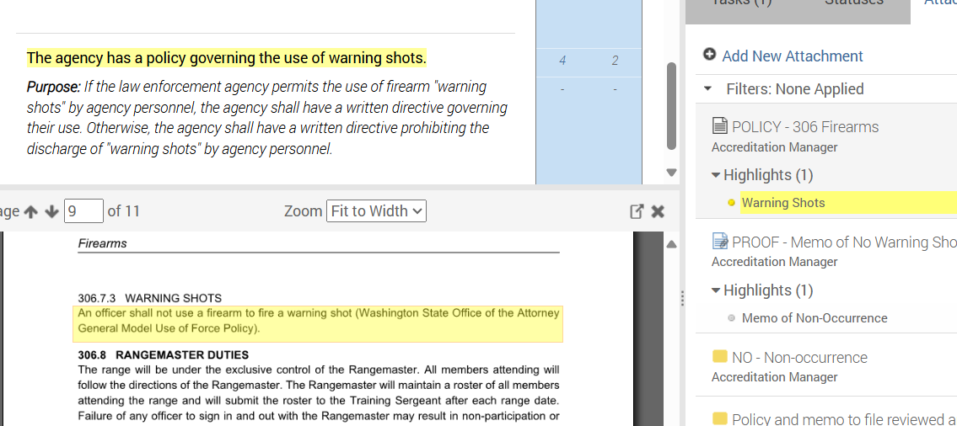
Hyperlink applicable policy sections

Slide 52
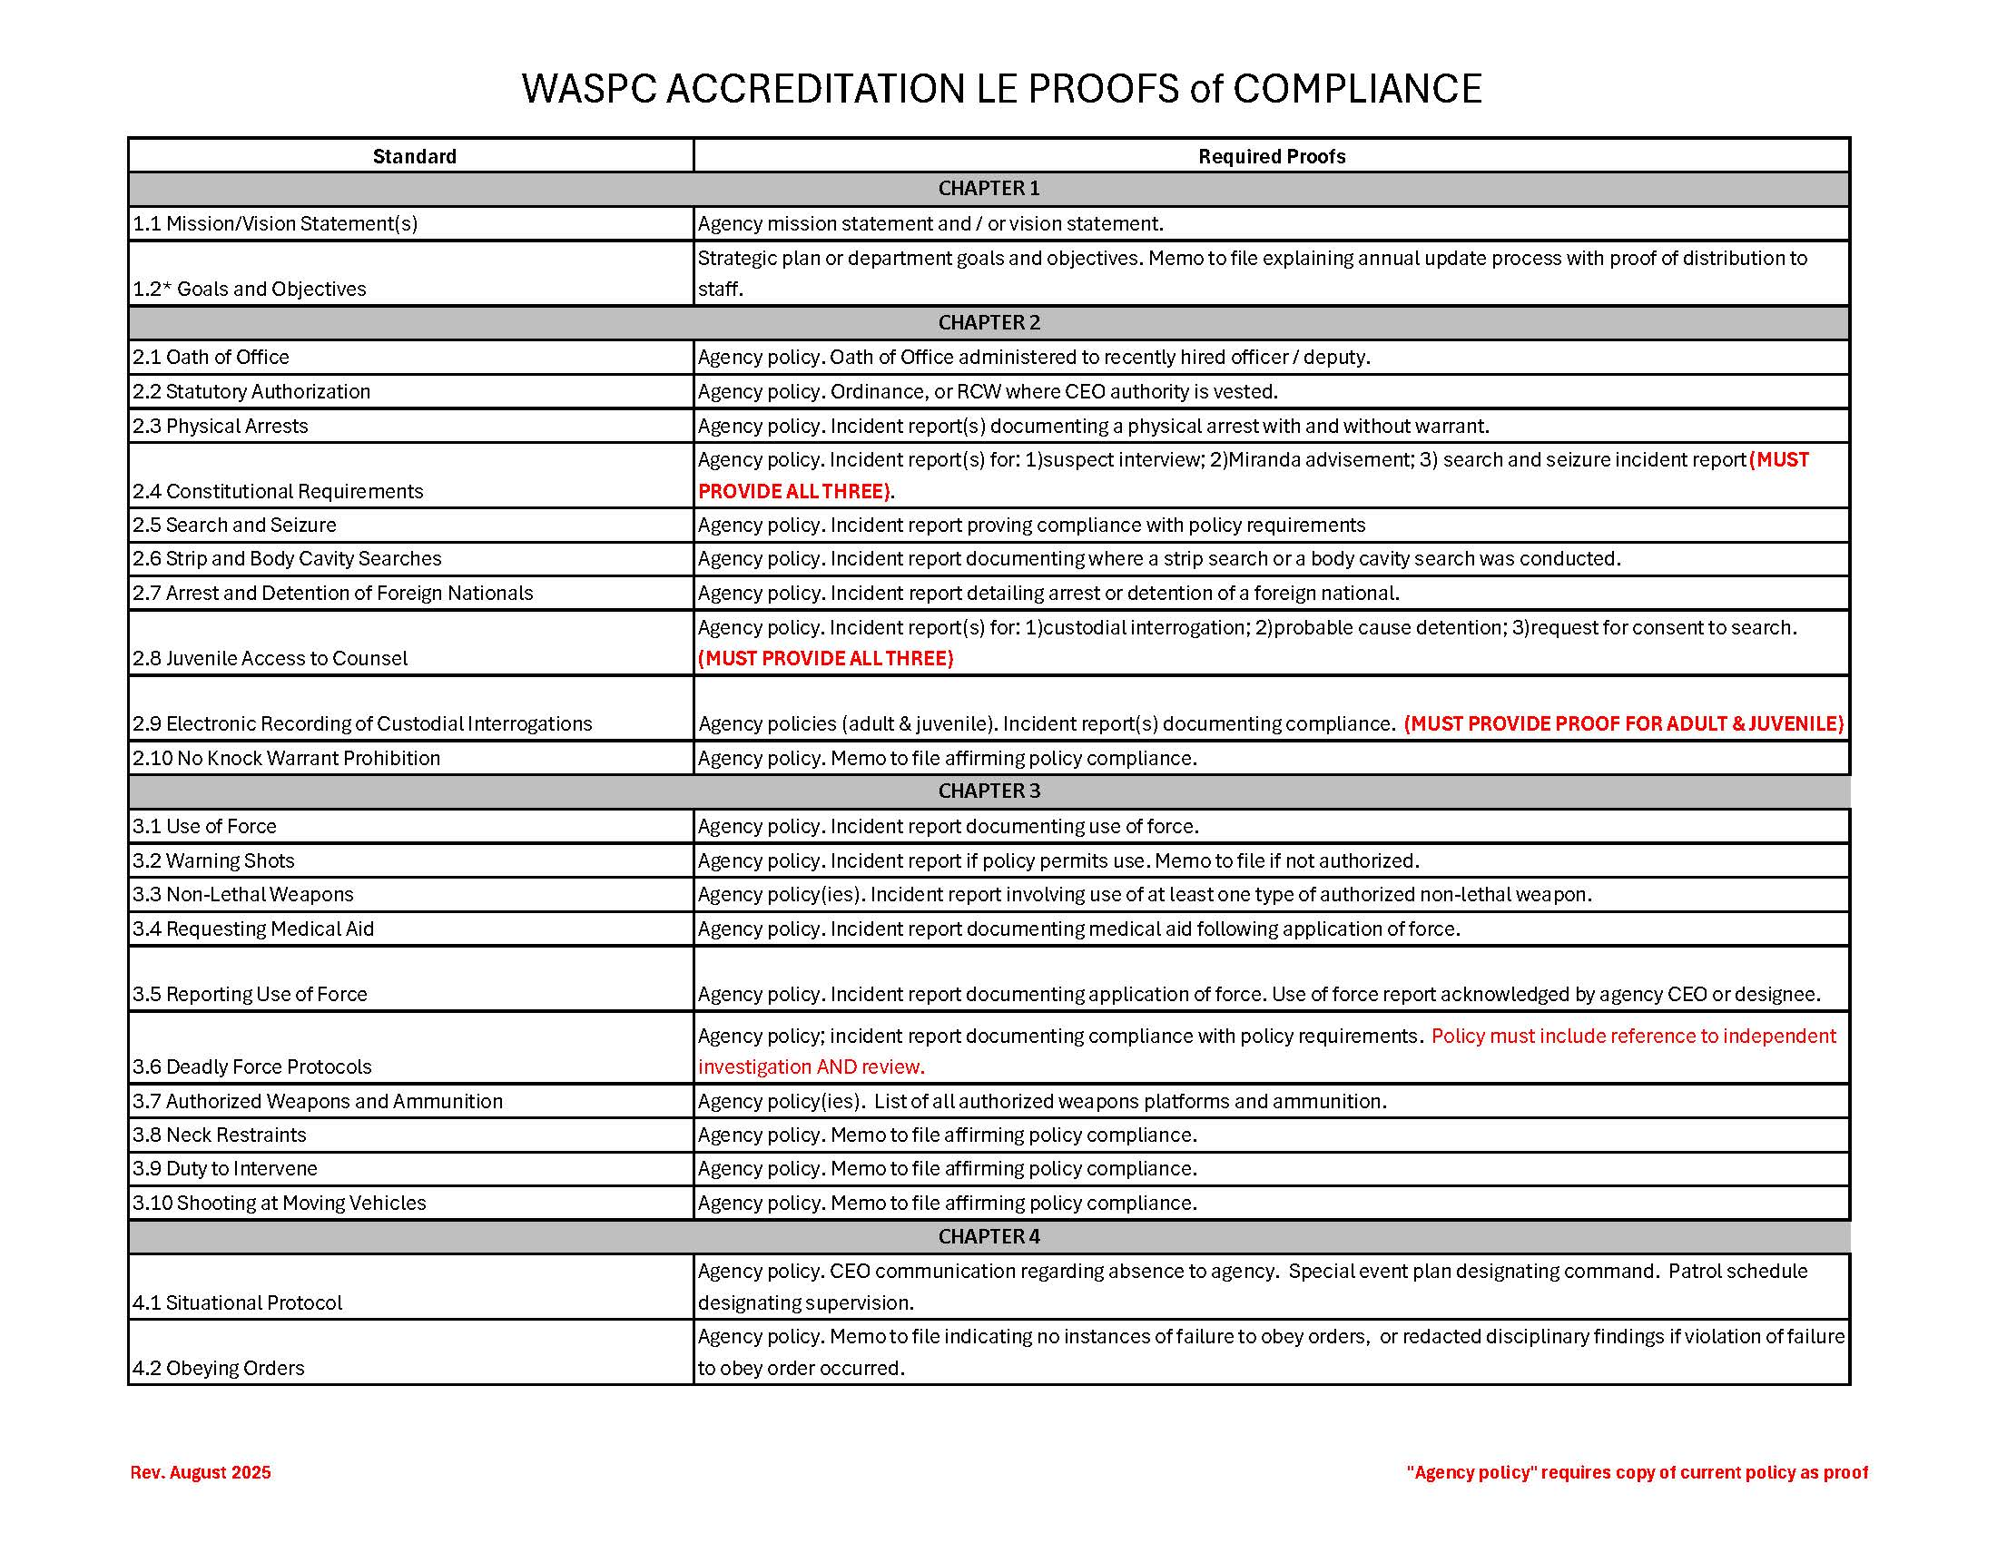
Accreditation Proof of Compliance Requirements Guide USE IT!!!!!
Notes:
Need to make reference to where this document is located and this location is where the most updated version is kept.

Slide 53
Standard 12.1* Performance Evals
The agency has an evaluation policy that requires formal written review of the work performance of each employee and is conducted annually.
Purpose: To ensure that regular evaluations of employee performance take place that includes identification of levels of performance, supervisory responsibility, and disposition of completed evaluations.
Notes:
Quick lesson on proofing a standard.

Slide 54
Standard 12.1*
Policy (highlight appropriate section)
Redacted Evaluations
Spreadsheet (annual standard)

Slide 55
4.3* Annual Reviews
The agency has a policy that requires an annual management review and analysis, with final review approved by the chief executive officer, of the following incidents:
• Vehicle pursuits
• Use of force events
• Internal investigations
• Biased based profiling incidents
Purpose: Agencies require ongoing first-level supervisory and administrative review of these high liability incidents. Additionally, an annual review and analysis of these incidents shall be conducted at the command level, with approval by the CEO, and can be used as an early warning system. Agencies should address policy, procedure, training and/or personnel issues identified during this review process.

Slide 56
Standard 4.3*
Policies for each one (highlight appropriate section)
Reviews/Analysis for each year
Ensure they are acknowledged by the CEO

Slide 57
Accreditation Assessor
  Now what?
    Stats on assessments / assessors
    What does an assessor do?
    How much time is involved?
R
Notes:
R Average of 10 assessments per cohort (spring / fall). At least three additional assessors for each assessment = opportunity for 60 assessors per year. Historically, because those who do good work get rewarded with additional work, the Accreditation program has relied on a small group of assessors who have become very proficient at their work.
Assessors are assigned standards as part of a virtual assessment. Assignments are generally chapters with the range between 2 to 5 chapters. During the virtual assessment, assessors evaluate proofs provided by the agency to determine whether or not the agency meets the proof requirements set out in the Proof of Compliance Requirements guide provided. Time commitment really depends on your level of experience and the degree to which you can ward off distractions to ensure your work gets done. Assessments are open for 7 days (5 business) and assessors usually take no more than ½ day to complete their work.

Slide 58

Role of the assessor
Confirm policy/procedure language adequately addresses the standard.
  Ensure proofs confirm compliance with policy, procedure or standard. Stay consistent with published standards of proof document.
    May be interacting with Accreditation Manager during file review.

Slide 59
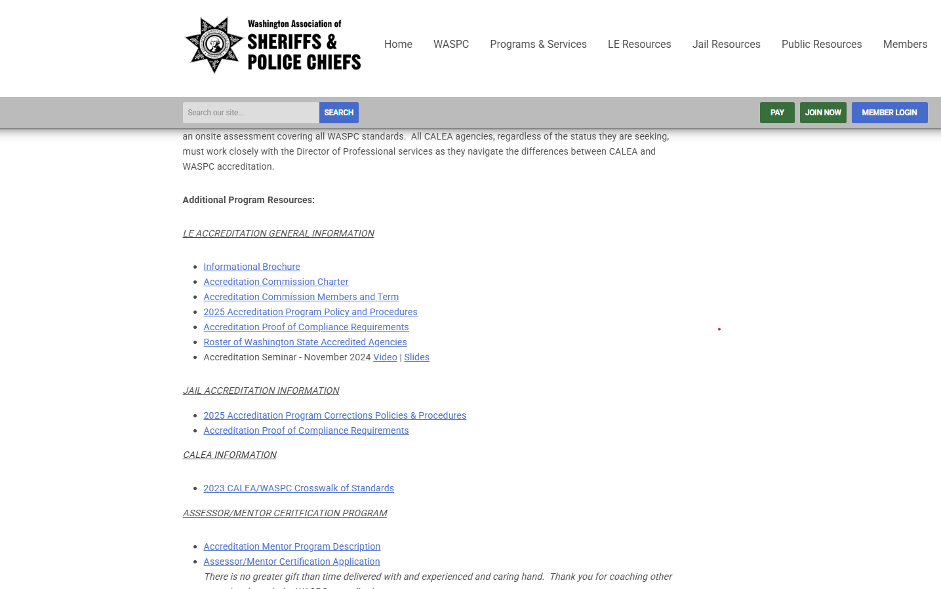
Accreditation Proof of Compliance Requirements
Notes:
Need to make reference to where this document is located and this location is where the most updated version is kept.

Slide 60
Accreditation Proof of Compliance Requirements Guide
Notes:
Need to make reference to where this document is located and this location is where the most updated version is kept.

Slide 61

Overreach
When you apply your standard of work onto the agency you are assessing.

Slide 62
Role of the Assessor (cont.)
Confirm policy/procedure language adequately addresses the standard.
  Ensure proofs confirm compliance with policy, procedure or standard. Stay consistent with published standards of proof document.
    Will be interacting with accreditation manager during file review.
  Contribute to final assessment report.
  Assessment team’s focus is on agency success.

Slide 63
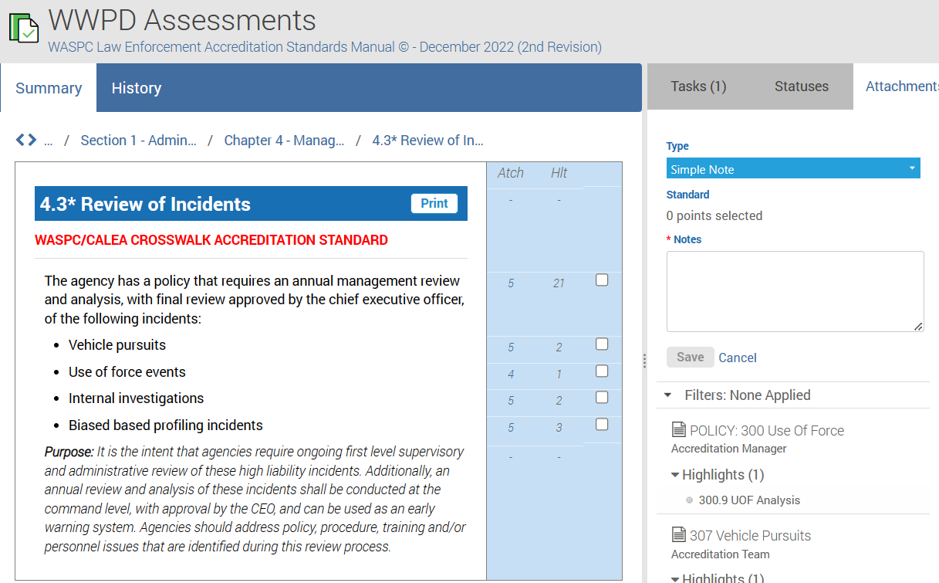
The ONE BOX Rule!
Only Check One Box

Slide 64
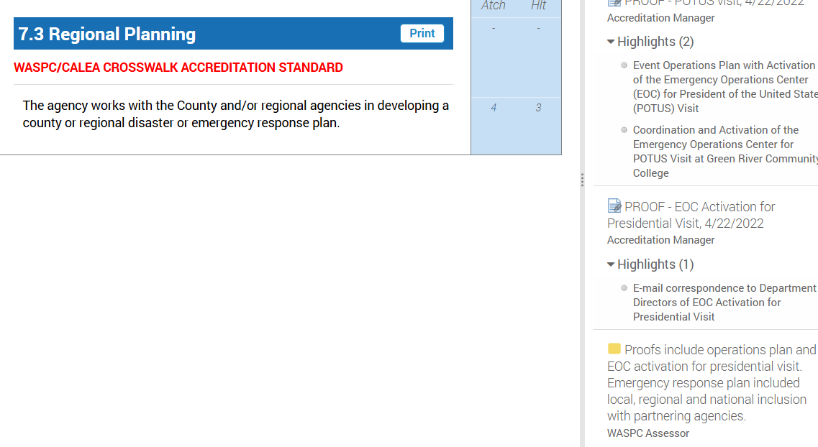
The ONE Simple Note Rule!!
Only Check One Box
Only create ONE simple note

Slide 65
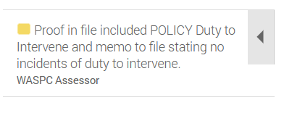
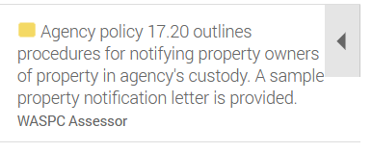
Good documentation
R

Slide 66
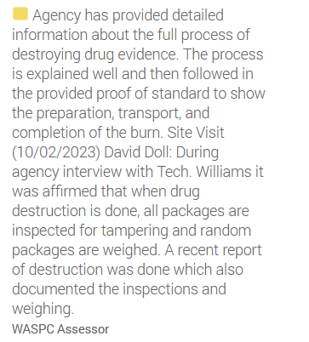
Good documentation

Slide 67
NOT so good documentation
Agency provided policy and proofs that comply with the standard.
More work is needed with this proof to gain compliance to the standard.

Slide 68
Specify what is needed to comply
File information is needed. Agency Policy Section 13.12 (Polygraph - Examiner Qualifications) indicates they will use a polygrapher who is professionally trained, credentialed and in good standing with the American Polygraph Association. You have provided a printout from the Northwest Polygraph Association for membership but American Polygraphy Association credentials are needed and confirmation of 30 hour training every two years, if available. Redacted polygraph is provided. Agency Policy Section 15.1 indicates a polygraphy test will be administered to all employment candidates.

Slide 69
QUESTIONS?

Slide 70

NEXT TRAINING DATE
March 17, 2027
10:00

Slide 71
Thank you!
David Doll
360-339-3390
ddoll@waspc.org
Randy Maynard
360-515-1204
rmaynard@waspc.org

